Slide 1

Retail Sales
Dashboard Analysis
Notes:
亲,本页特殊字体为“Century Gothic”,字体下载推荐网址HTTP://WWW.quitting.com/,下载解压缩后将字体复制至C盘WINDOWS文件夹里的FONTS文件夹下即可.更多同类作品,欢迎收藏不贰店铺:HTTP://ten.coder.com/works?use rid=14520189

Slide 2

Project Objective
01
02
03
Analyze retail dataset to simulate a real business case
Solve decision-making problems through Excel dashboard
Deliver dynamic, slicer-controlled insights

Slide 3
Tools & Technologies Used
Microsoft Excel (Core Tool)
Dataset: 5000 Retail Sales Records
Power Query
Pivot Tables & Pivot Charts
Slicers & Map Chart

Slide 4
Skills Applied
Data Cleaning & Preparation
Data Transformation & Modeling
Dashboard Designing
Business Problem Solving

Slide 5
Business Challenges → Actionable Insights
Category Performance
Geographical Insights
Identify which categories drive the most sales and profit.
Discover which states contribute the most to sales.
Profit Trends
Customer Growth
Analyze how profit changes across years.
Track total customer count across years.
Sales Seasonality
Dynamic Summary
Understand monthly and seasonal sales patterns.
Enable interactive filters (Category + Year) for deeper insights.
Top Customers
Highlight the most profitable customers.

Slide 6
Problem Insights
Monthly Sales → Peak in October, lowest in April
Category Sales → Furniture leads, followed by Office Supplies & Tech
Sales by State → Delhi & West Bengal dominate
Top Customers → Misha Chawla & Neysa Rege most profitable
Customer Growth → Consistent rise, sharp jump in 2024
Profit Trend → 2024 highest profit, Tech segment leads

Slide 7







Data Import & Cleaning
Imported CSV in Power Query
Removed duplicates, filled nulls
Fixed data types & formatted columns

Slide 8
Data Transformation
01
03
Created calculated fields
02
Split Order Date → Year & Month
Structured dataset for Pivot Tables

Slide 9
Pivot Table Creation
One pivot per business question
Ensured consistency across measures
Grouped, filtered, sorted as required

Slide 10


Interactive Controls
Made dashboard dynamic & user-driven
Slicers for Year & Category
Linked across multiple pivots

Slide 11
Visualizations Used
Bar Chart → Category-level sales
Line Chart → Profit over time
Area & Pie Chart → Monthly/Category mix
Map Chart → State-wise sales
Funnel Chart → Sales by Category

Slide 12
Dashboard Layout
Clean, professional design
Visuals grouped by business area
Balanced colors for easy interpretation

Slide 13
Dashboard Features
Slicers for real-time filtering
Segmented visuals for clarity
Minimalist design with professional palette
Built 100% in Excel – no macros/plugins

Slide 14
Dashboard Highlights
01
Fully dynamic and slicer-controlled dashboard
Designed for clarity, actionability, and user interaction
02
Covers multi-angle insights: category, time, geography, customer
Built 100% in Excel – no add-ins, just skills!
03
04

Slide 15
Key Insights
2024 = Record Profit Year
Delhi & WB strongest regions
Furniture = Highest Sales Category
Seasonal spike in October
Customers increasing steadily

Slide 16
Business Impact
Decision-makers can track category & regional sales drivers
Identify loyal, high-profit customers
Detect seasonality for planning inventory & promotions
Spot growth opportunities in emerging regions

Slide 17
What I Learned
30%
45%
43%
37%
Clarity-first reporting instead of just “pretty visuals
Building dashboards with storytelling in mind
Thinking like a stakeholder, not just an analyst
Advanced Power Query transformations

Slide 18

Challenges Faced
01
03
Handling inconsistent & missing data
Designing for clarity instead of clutter
02
04
Optimizing pivot performance on 5000+ rows
Choosing the right chart for the right story

Slide 19
Stakeholder Value
01
02
03
Sales Teams → Target profitable categories/customers
Marketing → Run seasonal campaigns in October peaks
Management → Track customer growth & future expansion areas

Slide 20
Storytelling with Data
Structured dashboard to answer “business questions, not just show numbers”
Insights flow from Category → Time → Customer → Region → Growth
Built narrative helps decision-makers act quickly

Slide 21



Future Improvements
Automate refresh with Power Query
Expand dataset with external sources (e.g., demographics)
Add KPIs like Customer Retention & Avg. Order Value
Build comparison view: Planned vs. Actual sales

Slide 22
Conclusion
01
02
03
04
Transform & Model Data using Power Query
Extract Business Insights with Pivot Analysis
Design Dashboards that tell stories, not just numbers
Think Critically from a decision-maker’s perspective
05
06
07
Connect Data with Decisions for practical impact
Use Excel as a Strategic Tool rather than just a calculator
Work with Clarity, Intent & Creativity in every analysis

Slide 23
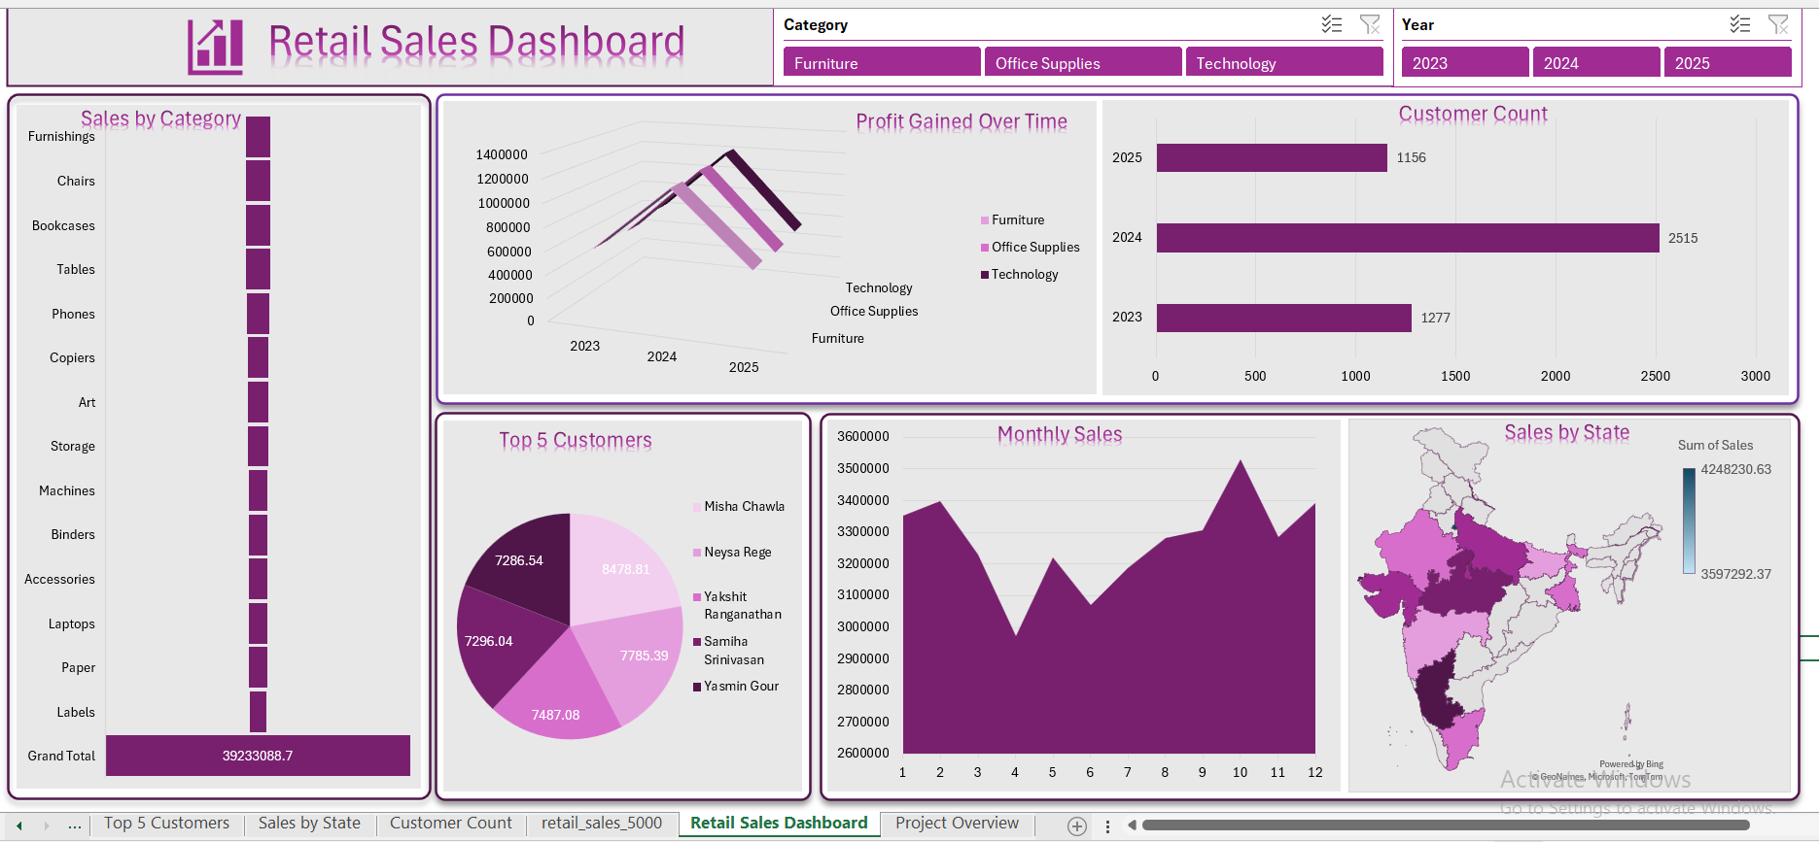
Final Dashboard

Slide 24

Project Overview

